Slide 1

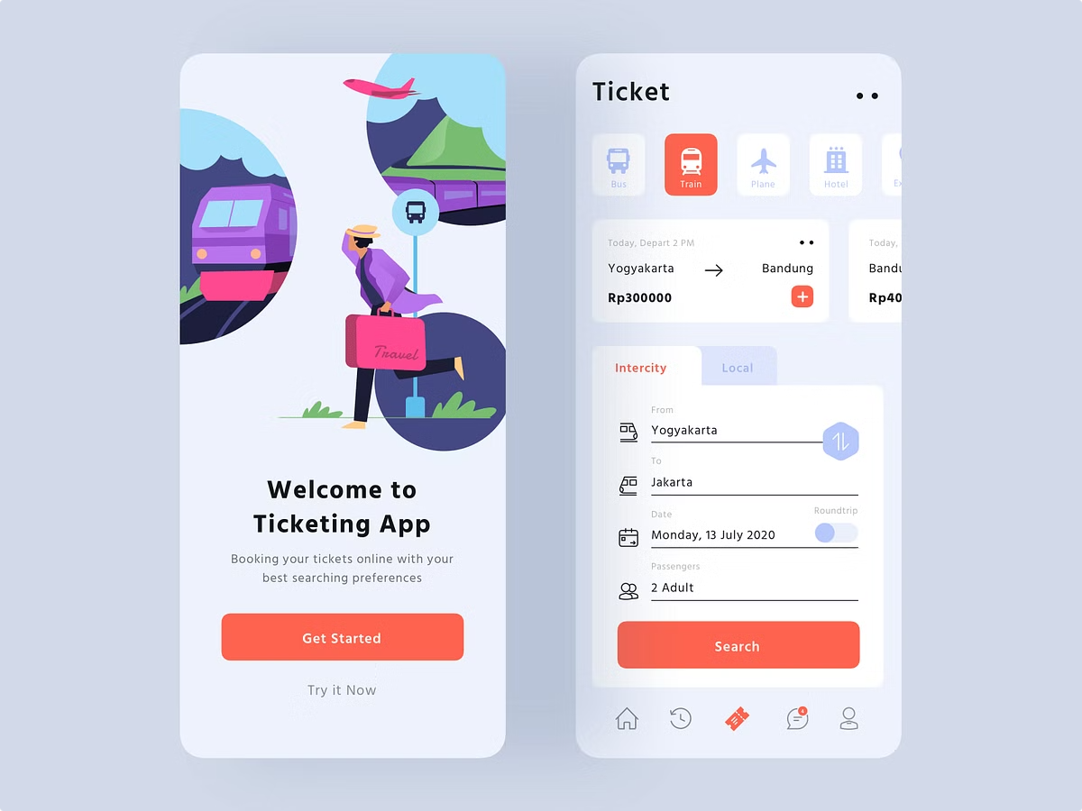
Introducing the Online Bus Ticket Booking System
Welcome to a seamless and convenient way to book your bus tickets online. Our system streamlines the entire booking process, offering a user-friendly and efficient experience.

Slide 2

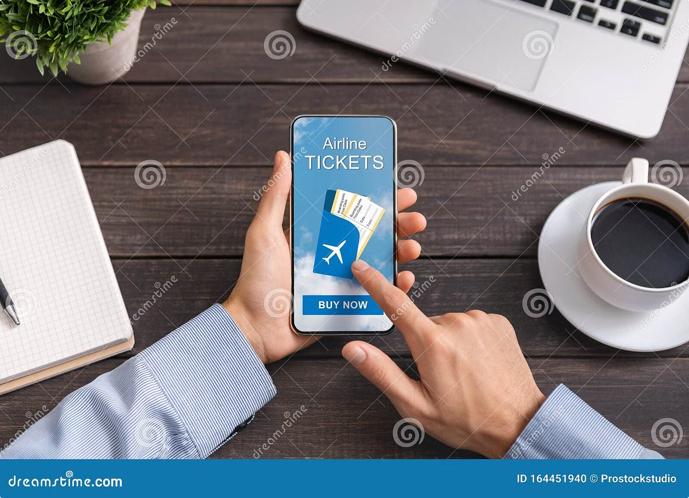
Convenience and Accessibility
Anytime, Anywhere
Wide Selection of Routes
Book your bus tickets from the comfort of your home or on the go, at any time that suits you.
Browse and choose from a vast network of routes across the country, covering major cities and towns.
Diverse Bus Operators
Find a wide variety of bus operators to choose from, catering to different budgets and preferences.

Slide 3

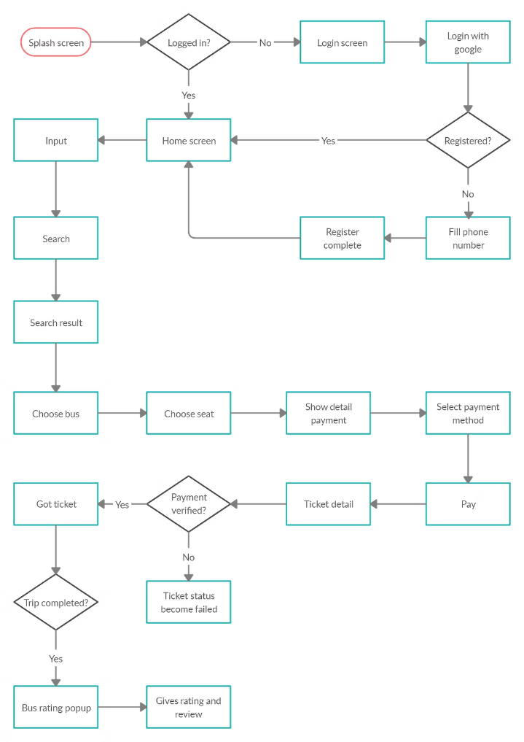
Booking Process Overview
1
Choose Your Route
Enter your departure and arrival cities, select your preferred date and time.
2
Select Your Seats
View available seats on the bus and choose your preferred location.
3
Review and Confirm
Double-check your booking details, including passenger information and payment options.
4
Receive Your Ticket
Your ticket will be emailed to you, with all the necessary information for your journey.

Slide 4
Seat Selection and Reservation
Interactive Seat Map
Choose Your Preferences
Real-Time Availability
View a detailed map of the bus, showcasing available and reserved seats.
Select seats based on your preferences, such as window seats, aisle seats, or seats with extra legroom.
The system displays accurate real-time seat availability, ensuring you get the seat you want.

Slide 5

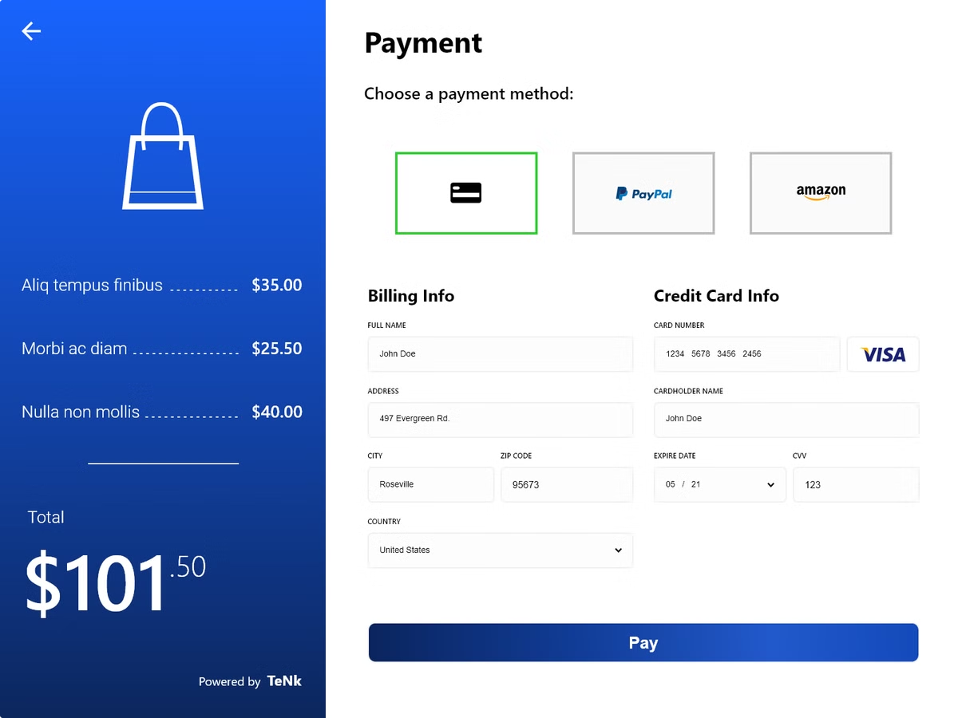
Payment Options and Security
1
Multiple Payment Methods
2
Secure Payment Gateway
Pay securely using various methods like credit cards, debit cards, or online banking.
Our system utilizes a secure payment gateway to protect your financial information during transactions.
3
Data Encryption
4
Fraud Prevention Measures
All sensitive data is encrypted using industry-standard protocols, ensuring maximum security.
We employ advanced fraud detection and prevention measures to safeguard your transactions.

Slide 6

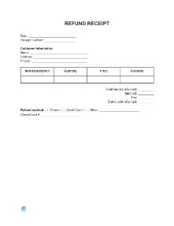



Ticket Cancellation and Refunds
Cancellation Policy
Request Cancellation
Refund Processing
Our system outlines clear cancellation policies for different ticket types and timeframes.
You can easily request a cancellation through the online system, following the designated steps.
Refunds are processed according to our policy, and you'll receive a notification regarding the refund status.

Slide 7

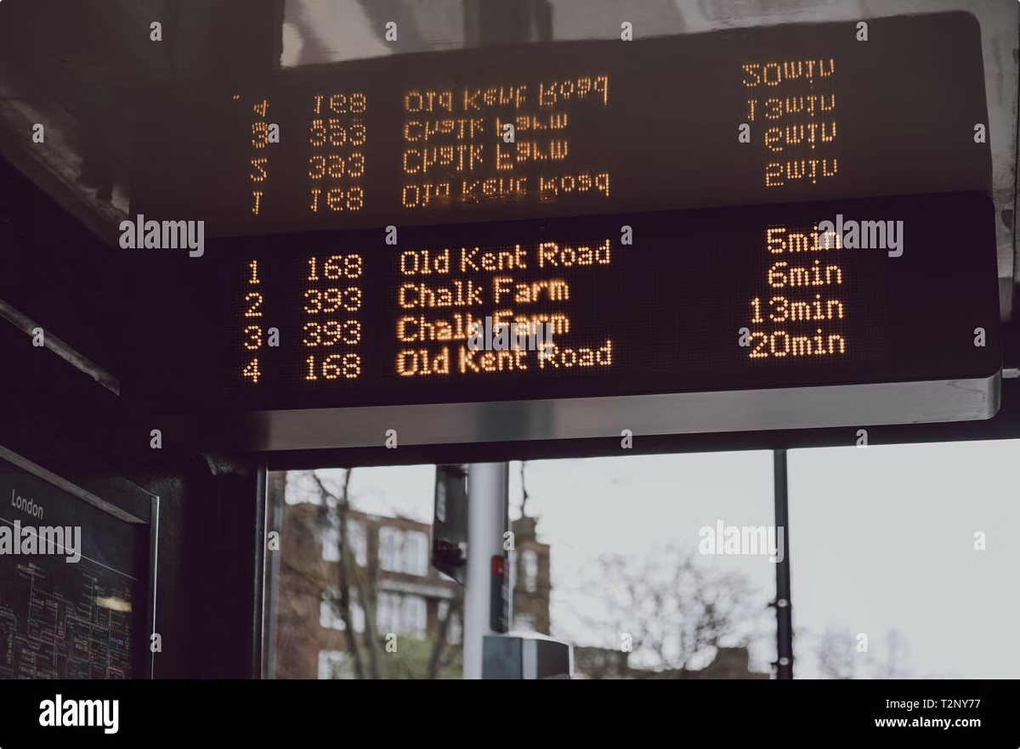
Real-Time Schedule Updates
Departure Time
Arrival Time
Status
08:00 AM
10:30 AM
On Time
11:00 AM
01:45 PM
Delayed (15 min)
04:00 PM
06:45 PM
On Time

Slide 8

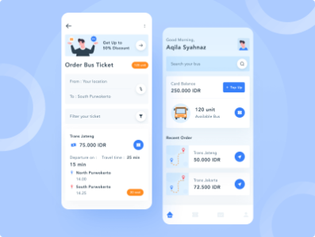



Mobile App Integration
On-the-Go Bookings
Digital Ticket Access
Real-Time Tracking
Book your tickets from anywhere at any time with our convenient mobile app.
Access your tickets directly through the app, eliminating the need for physical copies.
Track your bus in real-time and get notified of any schedule changes or delays.

Slide 9


Customer Support and Feedback
Dedicated Support Team
Feedback Portal
Our team is available to assist you with any inquiries or concerns you may have.
Share your feedback and suggestions to help us improve our services.

Slide 10


Conclusion and Key Benefits
1
Streamlined Booking
2
Enhanced Convenience
Enjoy a hassle-free and efficient online booking experience.
Book your tickets from anywhere, anytime, using your preferred device.
3
Secure Transactions
Rest assured that your personal and financial data is protected.

